Slide 1


TASK ON
Regex Matching Web App Development

Slide 2
About me
I did Complete Bachelor of Technology .
The motivations for learning data science can vary from person to person, but it often involves a combination of intellectual curiosity, career aspirations, and the desire to make a positive impact .
I am currently working as a data science intern .
GitHub Link :
LinkedIn :
https://github.com/dadipavankumar118
https://www.linkedin.com/in/pavankumardadi/

Slide 3
Scenario:
Develop a web application similar to regex101.com, aimed at providing users with a platform to test regular expressions (regex) against a given input string. Users can input a test string and a regular expression into the application. The application then processes the input, identifies and displays all matches found between the test string and the provided regular expression. This functionality empowers users to efficiently test and validate their regex patterns, aiding in various text processing and pattern matching tasks.

Slide 4
Steps:
Create a new directory for your project and navigate into it.
Set up your virtual development environment.
Initialize a new Flask application.
Create the HTML template.
Define a route to handle form submission.
Render the results.
Test your application.
Implement a new route where a user can validate if a given email id is valid or not.
Deploy the application on AWS Cloud.

Slide 5
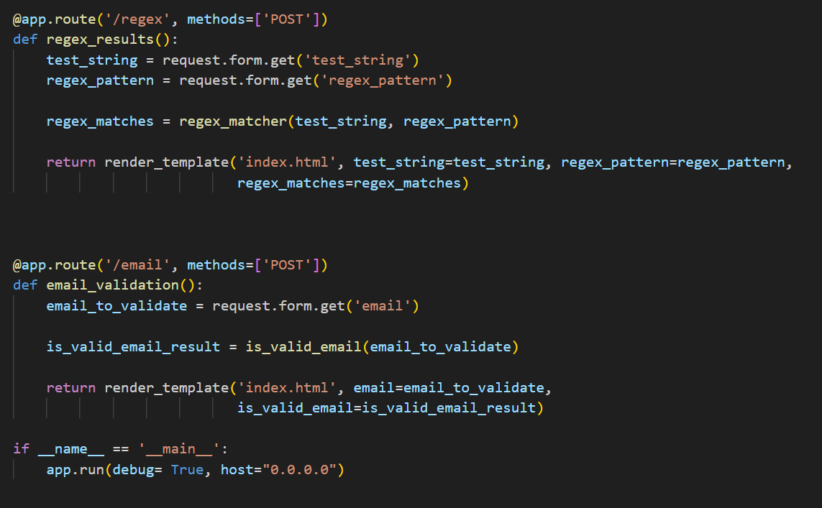
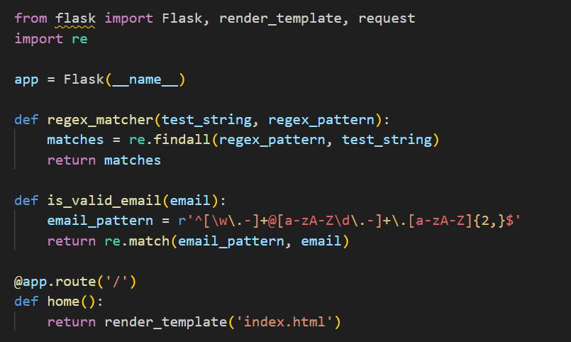
Initialize a new Flask application:-
This Flask application provides a platform for testing regular expressions and validating email addresses. Users input test strings and regex patterns to find matches, while also verifying email validity through a simple regex pattern.

Slide 6
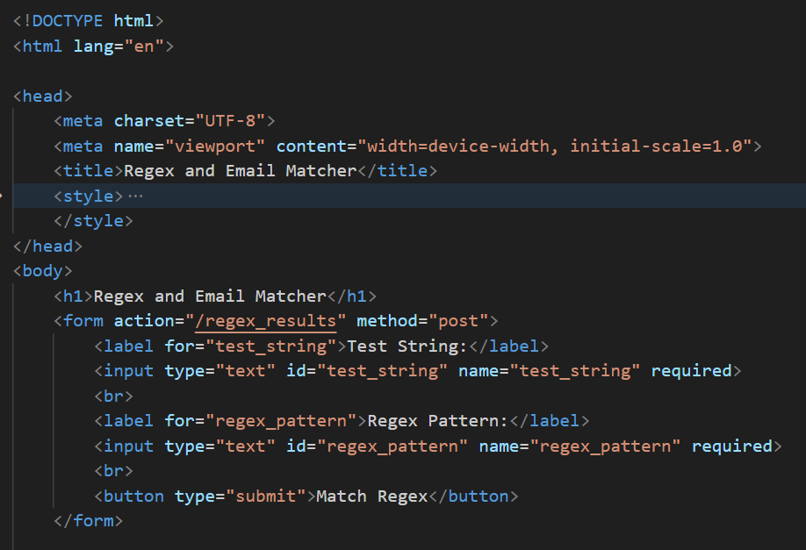
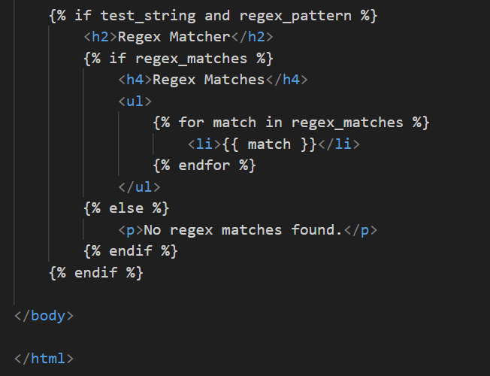
Create the HTML template:-
This HTML template creates a user-friendly interface for a Regex and Email Matcher web application. It includes forms for inputting test strings and regex patterns, as well as for validating email addresses. The design features a clean layout with CSS styling for enhanced readability. Additionally, it dynamically displays regex matches and email validation results based on user inputs, providing a seamless user experience.

Slide 7
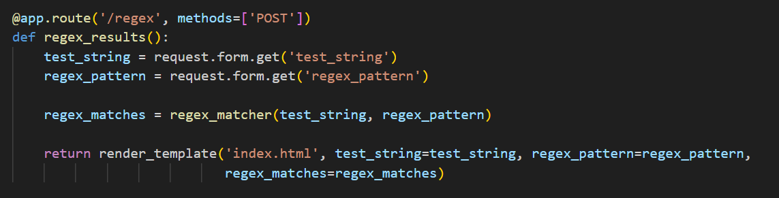
Define a route to handle form submission:
Handling form submission involves defining a route in the web application backend to receive form data sent by users. In this process, data such as input fields' values is extracted from the form using request methods provided by the web framework (e.g., Flask's request.form.get()). The extracted data is then processed as required, such as performing regex matching or other operations. After processing, the results may be stored or manipulated as needed before rendering a response, typically by rendering a template with the processed data for display back to the user.

Slide 8
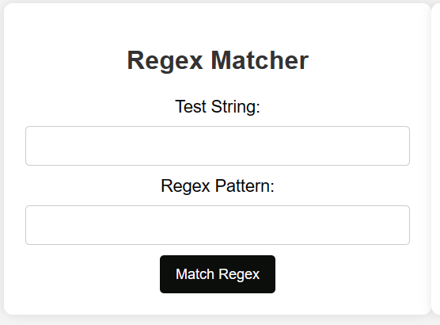
Render the results:-
The result of this application is a web interface where users can input test strings and regular expressions (regex) to perform matching. Upon submission, the application displays the matches found between the test string and the provided regex pattern.

Slide 9
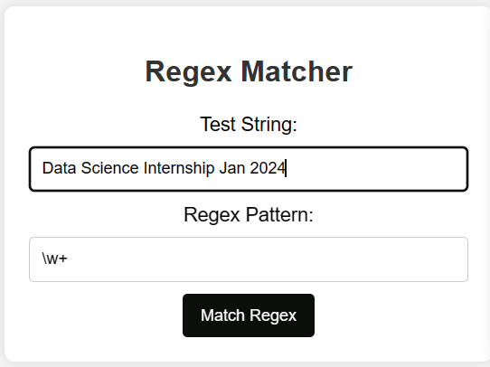
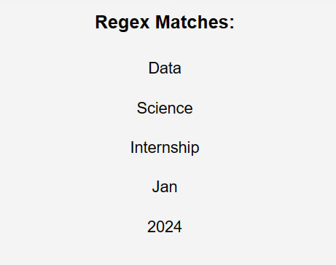
Test your application:-
This intuitive interface aids users in efficiently testing regex patterns enhancing text processing and pattern matching tasks.
Output:-

Slide 10
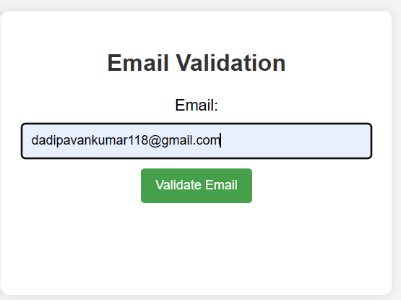
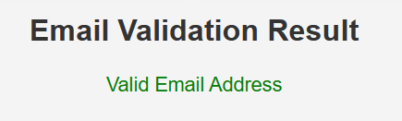
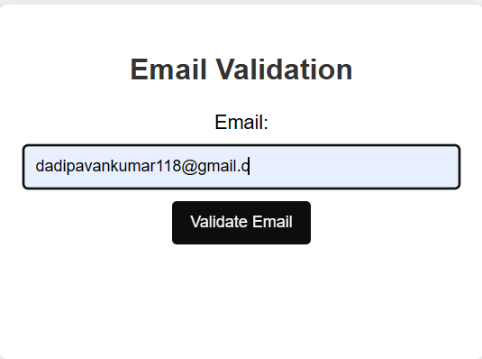
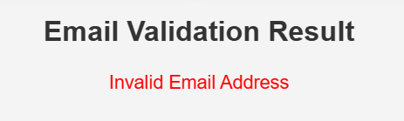
Implement a new route where a user can validate if a given email id is valid or not:-

Slide 11
Conclusion:-
In summary, I've replicated regex101.com's functionality, enabling users to input test strings and regexes to find matches. Utilizing Flask, we created routes for the home page and form submission, leveraging Python's re module for regex matching. We also added an email validation feature and deployed the app on AWS. Testing validated its accuracy, offering users a dependable regex testing tool, enhancing our Flask development skills and regex proficiency.

Slide 12

THANK YOU

